Slide 1


Thursday,
Sept. 27, 2018
This Photo by Unknown Author is licensed under CC BY-SA

Slide 2
ATTENTION GRADE 12s
All Grade 12s are invited to attend an information session regarding Grad Transitions at flex, this Friday, Sept 28th.
It's in your best interest to be there as GT is required for graduation.
See you in the Theatre.

Slide 3
Canadian Universities Events for SD43 Students & parents
Riverside Secondary: Thursday, October 04, 9 - 11 am in the Riverside gym
Pinetree Secondary: Thursday, October 04, 6:30 – 8 pm in the Pinetree gym
50 university recruiters from across BC, Alberta, the Prairie Provinces, Ontario, Quebec and the Atlantic Provinces will be available to answer questions about admission requirements, the application process, important dates and deadlines, programs available, study abroad, co-op or work experience opportunities, housing, scholarships and more!
If you are in grade 11 or 12 and considering your options for post-secondary this is a must attend event. Permission forms must be received for the Riverside event. See. Ms. Butler.
A complete list of participating schools is posted by the counselling entrance.

Slide 4

TERRY FOX RUN Bell Schedule
TODAY,
Thursday, Sept 27
Period 1 | 8.00 – 9.12
Period 2 | 9.16 – 10.19
Period 3 | 10.23 – 11.27
LOAD GYM | 11.27 – 11.40
PRESENTATION | 11.40 – 12.00
RUN | 12.00 – 12.30
LUNCH | 12.30 – 1.10
Period 4 | 1.14 – 2.17
Period 5 | 2.21 – 3.25
This Photo by Unknown Author is licensed under CC BY-NC-ND

Slide 5


Attention All Grade Nine’s!!
Starting next week there will be a mandatory flex – based on your advisory – to check in with Mr. Castonguay and Mr. Aitken – this will take place in Room 213.
Mark this date in your Calendar - Attendance will be taken
Tuesday September 11th - Advisory 1 – Mr. Chaffee
Wednesday September 12th – Advisory 2 – Ms. Gay
Thursday September 13th – Advisory 3 – Ms. Di Marco
**Monday October 1st **– Advisory 4 – Ms. Chen/Ms. Uchaz
Monday September 17th – Advisory 5 – Mr. Ciardullo
Tuesday September 18th – Advisory 6 – Mr. Bell/Mr. Aitken
Wednesday September 19th – Advisory 7 – Mr. Viveiros
Thursday September 20th – Advisory 8 – Mr. Gleckman
Monday September 24th – Advisory 9 – Mr. Castonguay
Tuesday September 25th – Advisory 10 – Mrs. Nunn/Mr. Lee
Wednesday September 26th – Advisory 11 – Mrs. Powell/Mrs. Walters
Thursday September 27th – Advisory 12 – Mr. Durand
Friday September 28th – Advisory 13 – Mr. Martin

Slide 6

KODIAK
ATHLETICS

Slide 7


Slide 8
Reminder to
ALL Swim Team members
Registration on Karelo must be completed by Friday, Sept 28th.
Please see Ms Mason if you need more information.

Slide 9

Sr Girls Basketball Tryouts
TODAY
Thu Sep 27 – 6:30-8:30 pm
Heritage Woods Secondary
Bring your water bottle, appropriate athletic wear, a reversible jersey, and a good attitude!!

Slide 10
KODIAK
CLUBS

Slide 11




Slide 12


Slide 13



Heritage Woods Key Club
Caring-Our Way of life
Come to room 201 at lunch
We meet every Thursday
It’s not too late to join!
Need volunteer hours?
Opportunities to provide service and enrich your sense of community
oldest and largest student led program for high school students

Slide 14


Slide 15

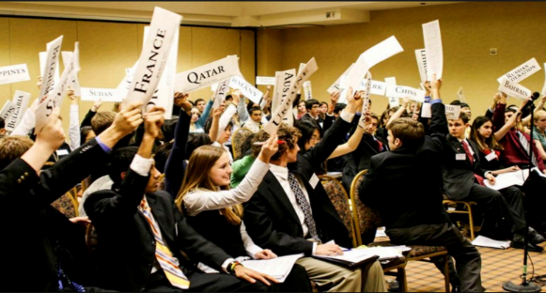
Model United Nations Club
Interested in improving your debating skills and learning about international issues?
Come to room 235 on Fridays @ lunch.
See Mr. Chaffee if you have any questions.

Slide 16


KWAP FUNDRAISER!!
Toonie Tuesdays!!
Next week October 2nd starting at 7:50 am, KWAP will be selling Starbucks coffee and a timbit for just 2$!!
All proceeds go to buying new socks and underwear for the people living on the downtown eastside!
Start off your morning right!!! :)

Slide 17
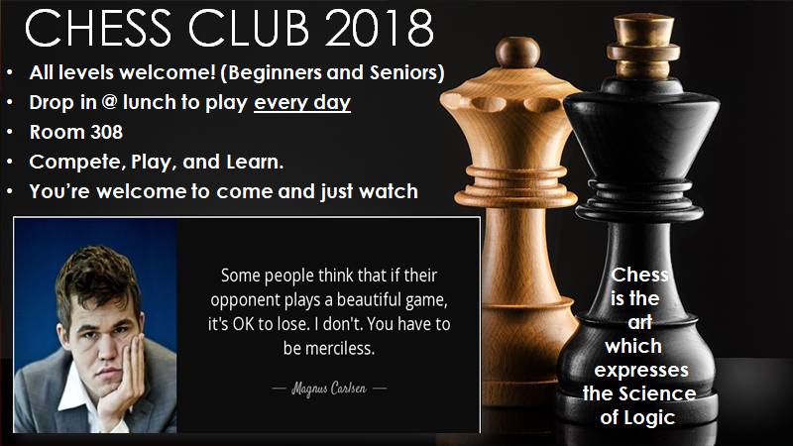

Slide 18
REPEAT
NOTICES

Slide 19
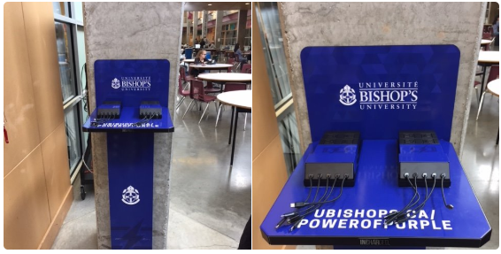
WE HAVE A New Charging Station!
Located across from the main office in the grand hall

Slide 20

THIS FRIDAY!

Slide 21
Heritage Woods
LANYARDS
for sale in the office.
$5.00
Show your school spirit!

Slide 22


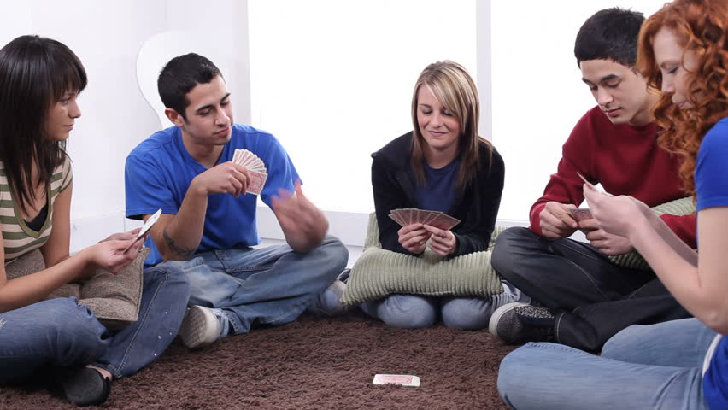
Are you at school early?
Looking for a place to relax before class?
Want some coffee, tea, cereal or toast to start your day?
Come play some games, listen to music, make something creative, chat with others or even just chill
Come to ROOM 231
EVERY MORNING 8:30-9:15

Slide 23


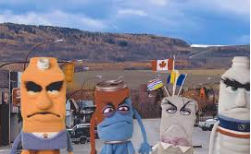
Please use recycling bins and garbage cans. Let’s keep HWSS clean!!!

